Slide 1
SLAMTRACKER

Slide 2
Description
IBM SlamTracker is the premier scoring application for Grand Slams which provides real-time scores, statistics, and point-by-by analysis of the Match.
Links to information sources
https://www.nextu.com/blog/ejemplos-de-big-data/
https://www.eluniverso.com/deportes/2014/12/11/nota/4329301/tenis-mas-informatico-slam-tracker
https://www.usopen.org/en_US/slamtracker/index.html
https://www.ibm.com/blogs/game-changers/ai-analytics-wimbledon-extracts-maximum-value-data/

Slide 3
WHY THE APPLICATION IS INTERESTING
IBM SlamTracker leverages player and ball position data to provide insights such as “Depth of Serve” and “Distance/Point” a player may have traveled along with traditional stats such as aces, winner, unforced error, etc.
IBM SlamTracker includes insights based on “pressure situations” within a match (down 0-40 in a game or down 2 sets, which show the historical performance for a player when in these specific “situations”, revealing hidden patterns in player and match dynamics.
In 2018 they redesigned the interface to give fans a full view of all the live action, as well as reintroducing “Momentum” which visualizes the competitive flow of the match.
IBM SlamTracker’s “Keys to the Match” feature is built using IBM’s predictive analytics technology (SPSS). The system analyzes over 12 years of Slam Tennis data analyzing players’ historical head-to-head match-ups, as well as against players with similar styles to determine what the data indicates each player must do to do well in the match.

Slide 4
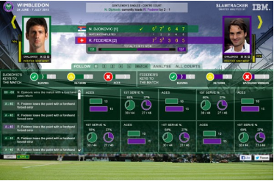
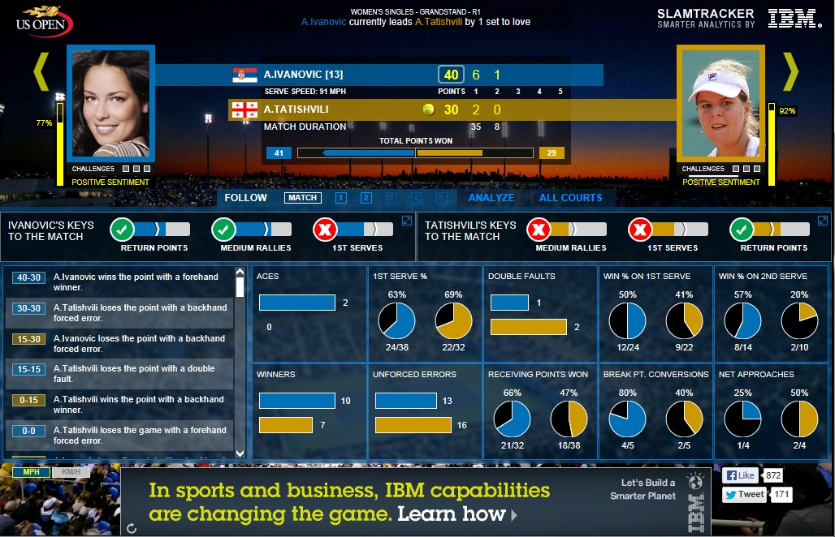
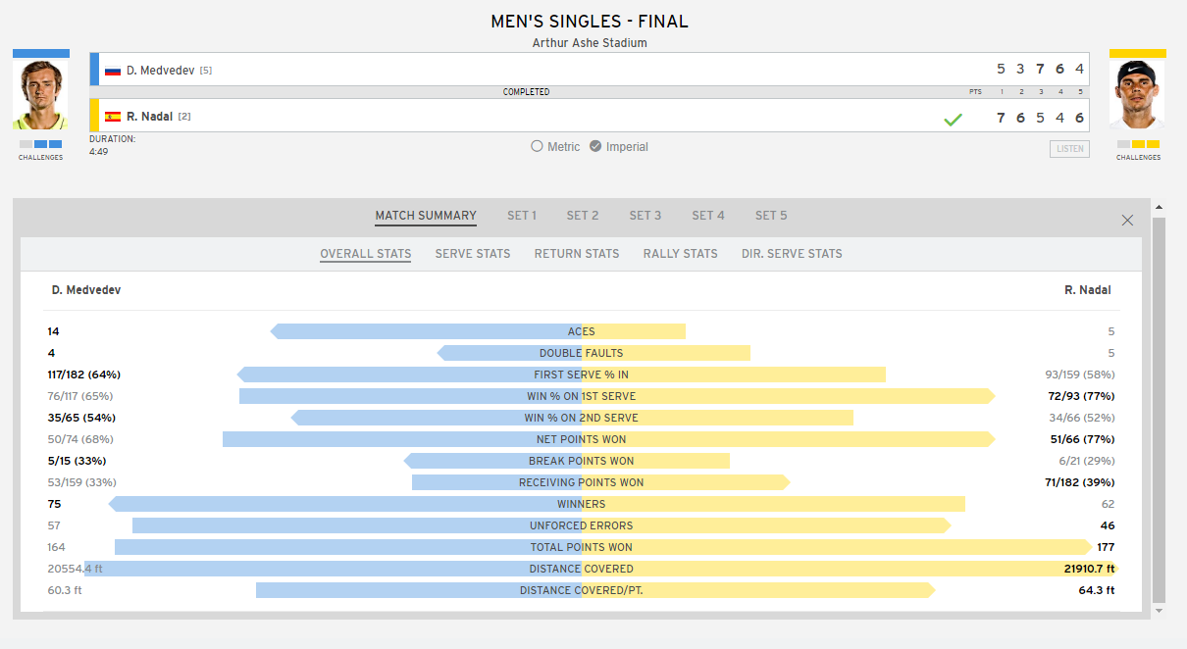
The 7 V's featured by the application

Slide 5
Volume
He system analyzes over 12 years of Slam Tennis data analyzing players’ historical head-to-head match-ups.
Until October 2018 he memorized 41 million points played in Grand Slam tournaments.

Slide 6
Velocity
Provides real-time scores, statistics, and point-by-by analysis of the Match.
They has sensors that cover every inch of the surface.

Slide 7

Variety In addition to the data stored for the last 12 years, they have three sources of real-time statistics generation. The first is the court. Each court has sensors that cover every inch of the surface. To that is added the annotations of the umpire that immediately impact on all the devices where the score of each match is published. The data collected also intersects with relaxed communications on social networks. The follow-up on Twitter of the games in the Open were analyzed by other software that allows you to evaluate the texts of the tweets from an emotional point of view to check the audience's behavior and favoritism towards the players.

Slide 8
Variability
Variability refers to variability in meaning, in the lexicon. In this case, the algorithms are aided by a group of tennis specialists that help them to be able to understand the context and decipher the exact meaning of each point and the context in which it was produced. This semantic analysis is much more complex.

Slide 9
Veracity
To provide truthfulness to the stored data, and to have as detailed information as possible, there is a group of tennis specialists who evaluate what type of point was played:
if it was a winner, an unforced error, right or upside down…
All these elements are unified on a basis of 44 million pieces of data.

Slide 10

Display
You have a graphic interface so detailed that if you missed the game, it allows you to read the game and know what happened at any moment as if you had seen it live.
Also, as this same interface can be followed in real time, you can analyze the moments that the player is going through, when he is more and less successful in each of the different strokes.

Slide 11
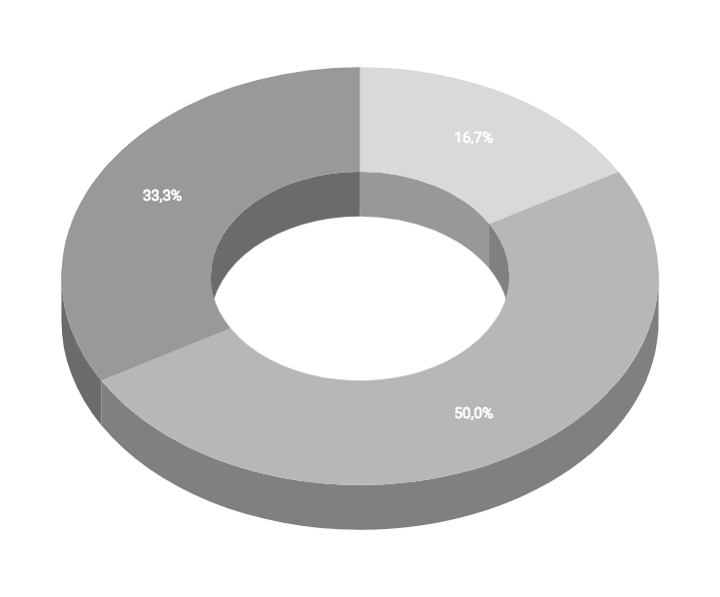
Value
Data analysis can be followed by viewers in real time.
They are also available to tennis players. They have reserved access to more detailed and complex information to understand how the game they just played was.
Other "hidden" data exists only for the organization. This data is not visible even to players.

